Slide 1
RATING PREDICTION
By : ARPITA MISHRA

Slide 2
Introduction
Present project aimed at building a model to predict star rating based on the review.
Around 20,000 reviews and ratings of different laptops, phones, smart watches, cameras were scrapped using selenium as a tool.
These review and ratings data were used to build a model for star rating prediction
Data Collection
Using Selenium web driver, review and ratings were fetched for different products from e-commerce sites.
These data were saved in the form of csv file.

Slide 3
Scraping data
import all the required libraries
import pandas as pd
import selenium
from selenium import webdriver
import time
from selenium.common.exceptions import StaleElementReferenceException, NoSuchElementException
driver=webdriver.Chrome("chromedriver.exe")
time.sleep(3)
url = "https://www.flipkart.com/apple-iphone-11-black-64-gb-includes-earpods-power-adapter/product-reviews/itm0f37c2240b217?pid=MOBFKCTSVZAXUHGR&lid=LSTMOBFKCTSVZAXUHGREPBFGI&marketplace=FLIPKART"
driver.get(url)
time.sleep(2)

Slide 4
#creating empty list
urls=[]
stars=[]
complete_review=[]
time.sleep(5)
#Taking 50 pages into consideration using for loop
for i in range(50):
url=driver.find_element_by_xpath("//a[@class='_1LKTO3']").get_attribute('href')
driver.get(url)
#for scrapping the number of stars
for j in driver.find_elements_by_xpath("//div[@class='_3LWZlK _1BLPMq']"):
stars.append(j.text)
#for scrapping the complete review
for k in driver.find_elements_by_xpath("//div[@class='t-ZTKy']/div/div"):
complete_review.append(k.text)
#Combining all the lists into a single dataframe
df1=pd.DataFrame({'Number of Stars': stars,'Full Review': complete_review})
df1

Slide 5
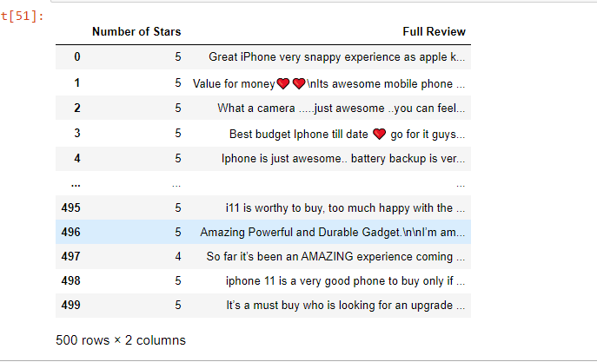
Similarly, ratings and review were fetched for multiple products to get around 20,000 data. These data were saved in csv file and will be used for model building

Slide 6
For model building, all the necessary libraries like Pandas, numpy and matplot lib were imported on jupyter notebook.
The data set was loaded as df by using pd.read_csv. The shape of the dataset was found to be 20370 rows and 3 columns.
The columns included the review and their respective ratings of several electronic products.
To see if the dataset was balanced or not value_counts() was used which showed that the dataset was not imbalanced.
df['Number of Stars'].value_counts()
5 11920
4 4124
1 2227
3 1744
2 355
Name: Number of Stars, dtype: int64

Slide 7
Data PreProcessing
The data collected from the e-commerce websites was not clean. So the data had to be preprocessed before it could be used to train a model. All the text in the data were converted in lower case, punctuations, special characters and digits were removed.
First round of cleaning
import re
import string
def text_clean_1(text):
text=text.lower()
text=re.sub('\[.*?#]','',text)
text=re.sub('[%s]'%re.escape(string.punctuation),'',text)
text=re.sub('\w*\d\w*','',text)
return text
cleaned1=lambda x:text_clean_1(x)
df['cleaned_FullReview']=pd.DataFrame(df['Full Review'].apply(cleaned1))

Slide 8
After the first round of cleaning, all the punctuations and digits were removed. However, emojis were found in the text.
Therefore, all the emojis present in the data were removed in second round of cleaning.
Second round of cleaning
def text_clean_2(text):
text=re.sub('\n’, ‘’, text)
text=re.sub(emoji.get_emoji_regexp(), r‘’, text)
return text
cleaned2=lambda x:text_clean_2(x)
df['cleaned_review_final']=pd.DataFrame(df['cleaned_FullReview'].apply(cleaned2))

Slide 9
Model Building
The data were split into x and y using train-test-split.
The review was used as independent variable while the rating was used as dependent variable(label).
TFIDF vectorizer was imported for word embedding and Linear SVC was used to build the model.
A pipeline was created which included firstly vectorization followed by the use of classifier.
The model was trained by model.fit using train data set.
The trained model was used to predict the rating from test data. The predicted data along with ‘y_test’ data was used to find accuracy score, confusion matrix and classification report.

Slide 10
Importing libraries
from sklearn.model_selection import train_test_split
from sklearn.feature_extraction.text import TfidfVectorizer
from sklearn.metrics import accuracy_score, classification_report, confusion_matrix
from sklearn.svm import LinearSVC
tvec=TfidfVectorizer()
clf2=LinearSVC()
from sklearn.pipeline import Pipeline
Creating Pipeline
model=Pipeline([('vectorizer',tvec),('classifier',clf2)])
model.fit(x_train,y_train)
pred=model.predict(x_test)
print(confusion_matrix(pred,y_test))
print(accuracy_score(pred,y_test))

Slide 11
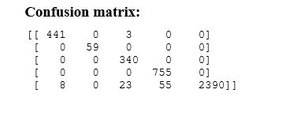
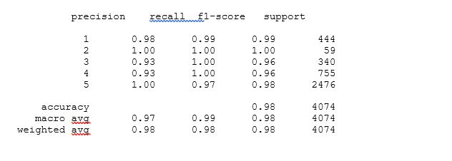
Result
The accuracy score was found to be 97.8 percent. The model was tested on a new review and was found to have a good accuracy.
Classification report

Slide 12
Saving the model
The model was saved using joblib.
import joblib
filename='ratingmodel.pkl’
joblib.dump(model,'ratingmodel.pkl’)
Summary and conclusion
Thus, in the present project, review and rating of several electronic product were scrapped to be used to build a model that can be used to predict ratings based on the review.
A linear SVC model was build which exhibited the accuracy of almost 98 percent.
This model will be now used to predict ratings on a new review.

